Slide 1





Fast Tile-Based Adaptive Sampling With User-Specified Spectra
Florent Wachtel¹ – Adrien Pilleboue¹ – David Coeurjolly² – Katherine Breeden³ – Gurprit Singh¹ – Gaël Cathelin¹ – Fernando de Goes⁴ – Mathieu Desbrun⁴ – Victor Ostromoukhov^{1,2}
1
2
3
4
Notes:
Good morning everyone.
I'll present a novel tiled-based sampling method that can generate point distributions with arbitrary user-specified spectra.
This work is the result of a collaboration between the French lab CNRS-LIRIS, Stanford and Caltech.

Slide 2
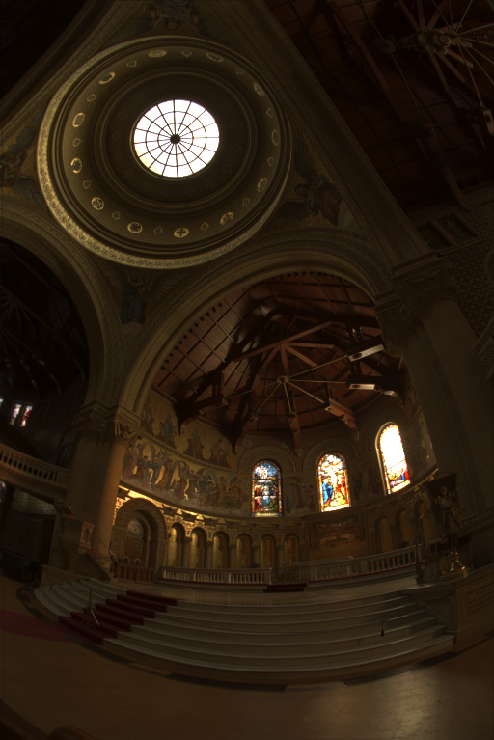
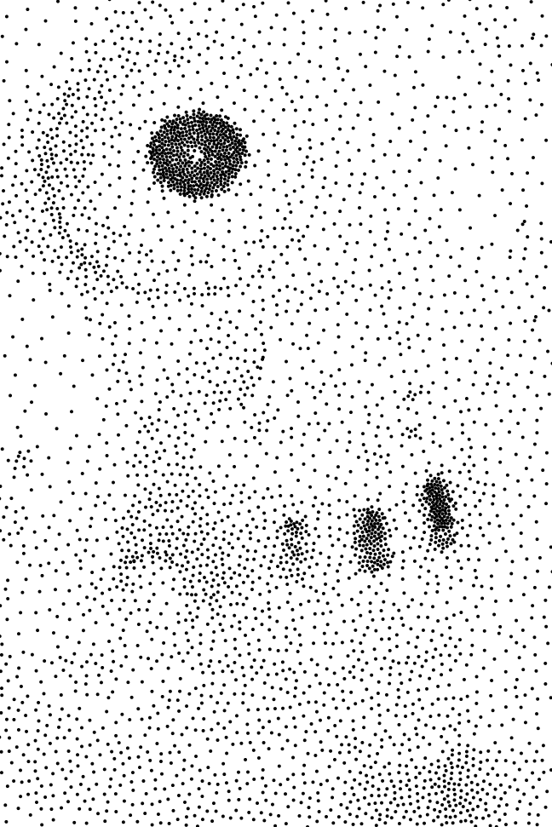

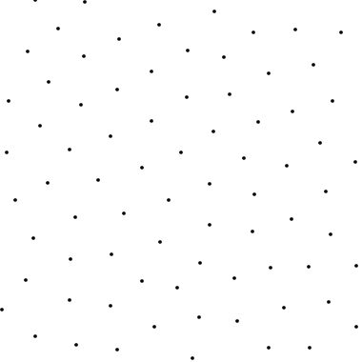
Problem Statement
Find a discrete sample distribution with density locally proportional to d(x, y)
Given a density function d(x,y)
courtesy of P. Debevec
Notes:
Put simply, sampling is the process of discretizing a continuous function.
Intuitively, we want the samples to be evenly distributed, and often, to have a local density of samples proportional to the local value of the function.
& When these samples are then used for reconstruction or integral approximation, the nature of their distribution will have a big impact on the quality of the results.

Slide 3
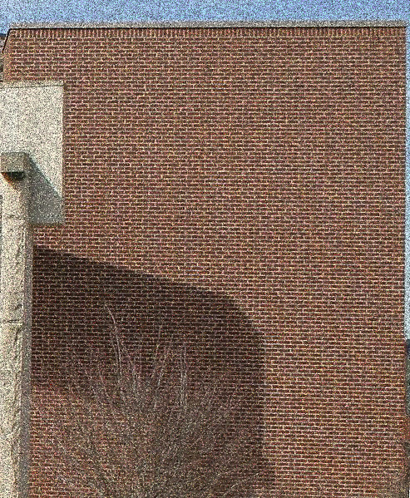
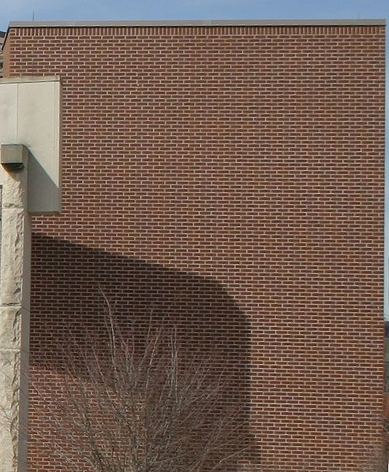
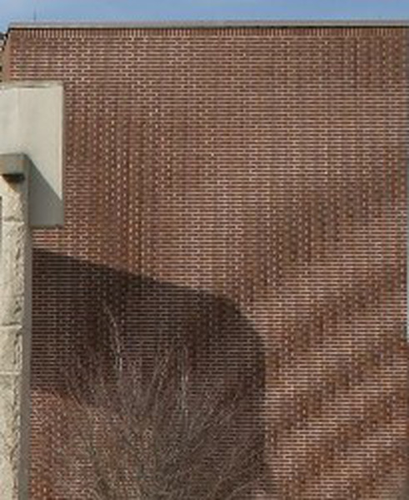
Why it is essential?
Two main issues when sampling a function:
Noise: too few samples
Reference
Aliasing: samples too regular
Notes:
For example, as shown on the left, local sparseness of samples generates a noisy reconstruction.
====
Another issue can be aliasing, which results from the interference between regularities in sampling and regularities in the function.

Slide 4

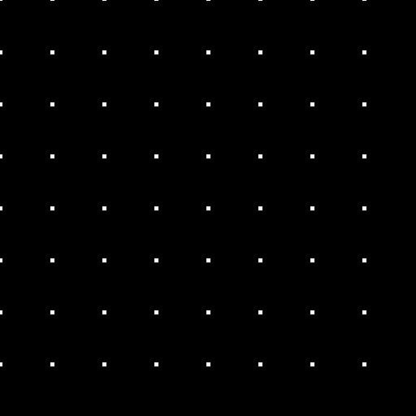
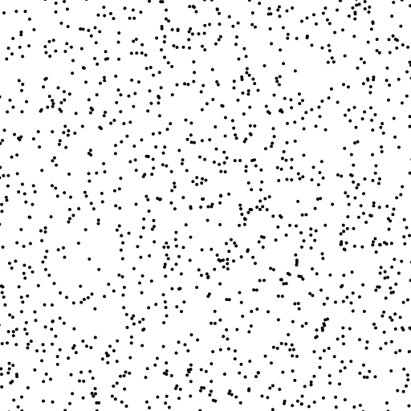
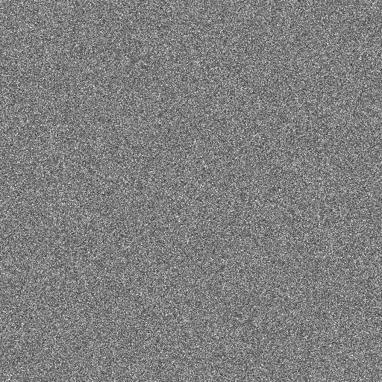
Context
Regular Sampling
Random Sampling
Pro: Uniform
Con: Aliasing when sampling frequency is below Nyquist frequency
Pro: No regularity
All frequencies equally sampled
Con: Voids and Clusters
Distribution
Fourier Spectrum
Distribution
Fourier Spectrum
Notes:
The simplest way to generate sample positions is to calculate a rectangular grid.
This method has the advantage of sampling the whole space uniformly,
but it produces strong aliasing artifacts when the sampling frequency is smaller than twice the maximum frequency of the function.
====
Another simple solution is to choose the position of each sample at random.
In this type of distribution, all frequencies are equally sampled.
This is indicated by the constant Fourier spectrum.
However, this distribution doesn't guarantee local uniformity, as you can see by the presence of regions with either too few, or too many samples.
These voids and clusters will produce noisy images when the samples are used in reconstruction or integration.

Slide 5

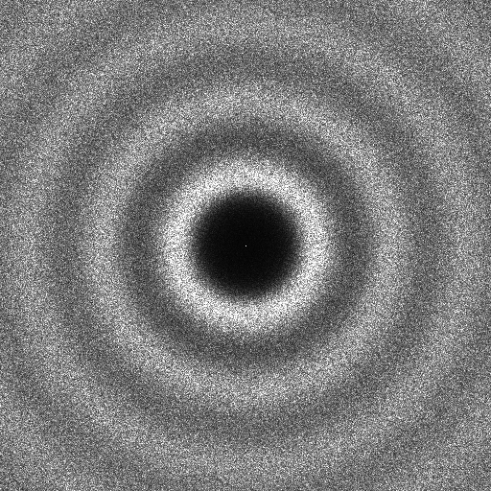

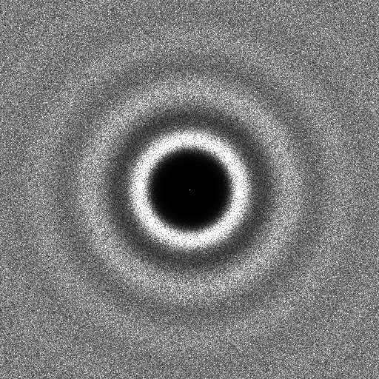
Previous work: Advanced Methods
Poisson Disk Methods
Optimization-based Methods
Stochastic
Force uniformity with exclusion disk
[Cook 1986][McCool et al. 1992][Wei 2008]
Minimize energy function
[Balzer et al. 2009][Fattal 2011]
[Schlomer et al. 2011][de Goes et al. 2012]
Distribution
Fourier Spectrum
Distribution
Fourier Spectrum
Notes:
Since the nineteen-eighties, many algorithms have been proposed to enhance sampling quality given a constant number of samples.
In Poisson Disk methods, a random sample position is chosen, while respecting constraints on minimum allowed distances between pairs of points.
This method guarantees much better uniformity when compared with random sampling.
====
There are also other methods based on optimization.
The core of these methods is the minimization of an energy function associated with the samples.
Currently, the best-quality sampling distributions are obtained with this kind of method.
Such distributions and spectra are known as blue-noise, and are very popular in computer graphics.
Notice that neither Poisson disk nor optimization-based methods contain frequency peaks in the spectral domain.
This alleviates the production of aliasing artifacts.
& While these methods can successfully generate distributions with superior blue-noise spectra, there are instances in which we may need other types of distributions.

Slide 6

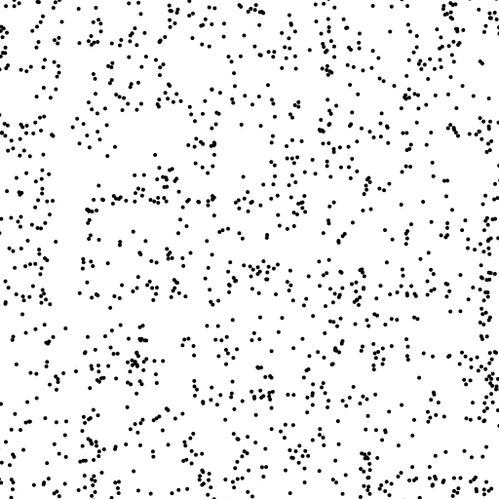
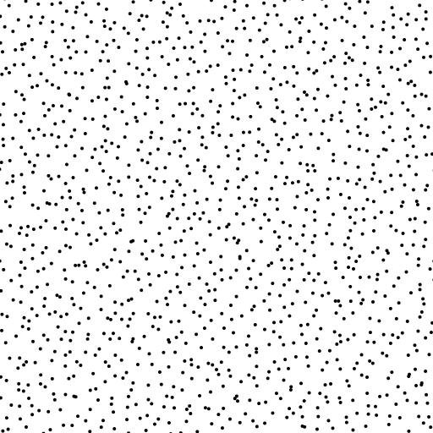
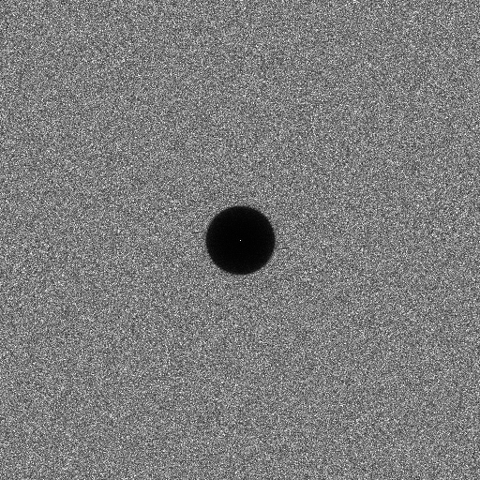
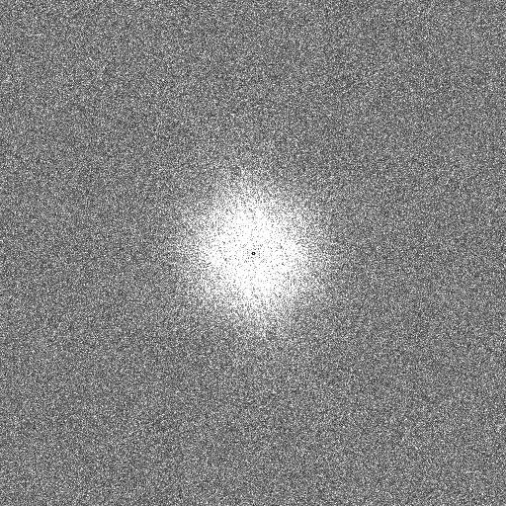
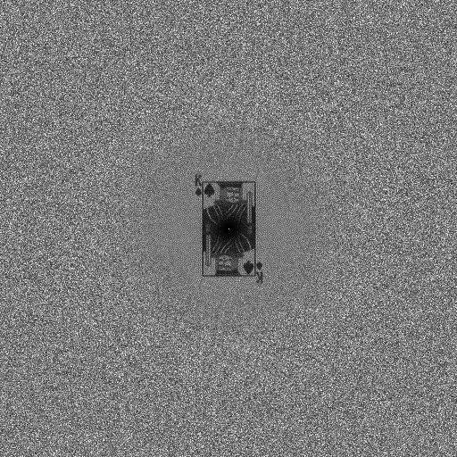
Previous work: General Noise Methods
Each application requires its own spectral characteristics
[Wei et al. 2011][Zhou et al. 2012][Oztireli et al. 2012][Heck et al. 2013]
Step noise
Pink noise
King noise
Distribution
Distribution
Distribution
Fourier Spectrum
Fourier Spectrum
Fourier Spectrum
Notes:
In the last two years, new methods have been proposed to generate sampling distributions with user-specified Fourier spectra.
They allow for the generation of distributions with properties best adapted for particular applications.
& Unfortunately, most of these advanced sampling methods are not yet suitable for practical use due to their complexity and runtime speed limitations.

Slide 7
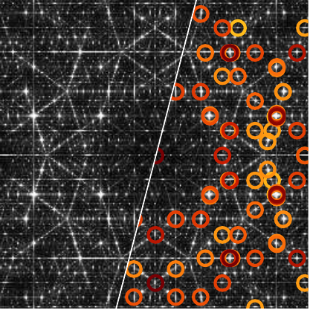
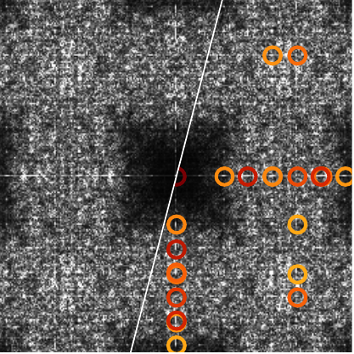
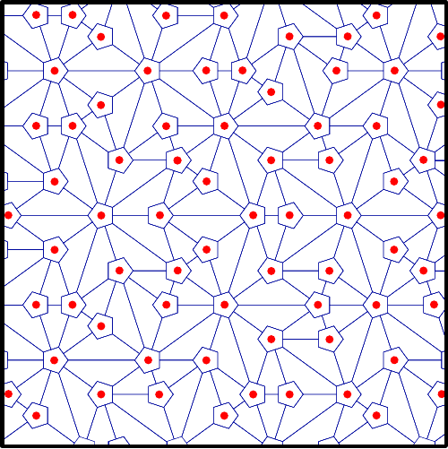
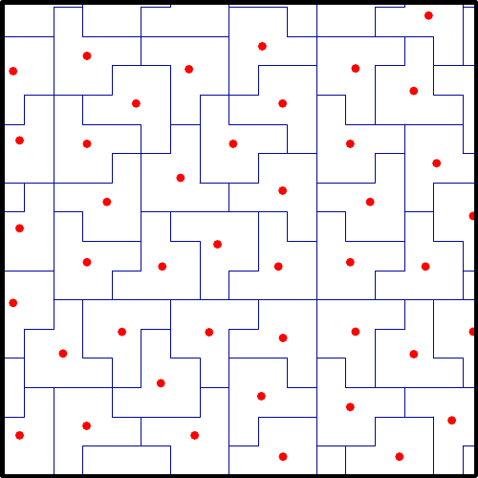
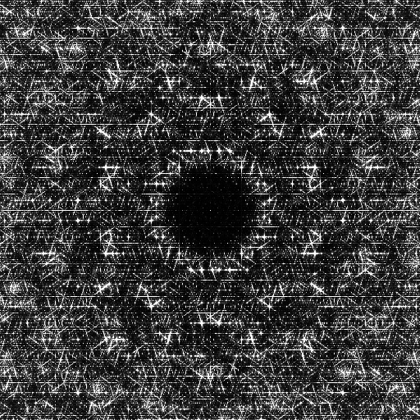
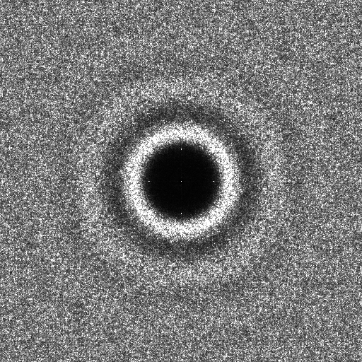
Previous work: Tile-based Methods
Store precomputed samples in a hierarchical and non-periodic tiling system
[Ostromoukhov et al. 2004, 2007] [Kopf et al. 2006] [Lagae et al. 2006]
Penrose Tiling
Polyominoes Tiling
before optimization
before optimization
Fourier Spectrum
Fourier Spectrum
after optimization
after optimization
Distribution
Distribution
Notes:
Tile-based methods aim at reducing the time complexity of generating samples, while still producing sufficiently good sampling distributions.
These methods generally contain two steps:
First, a hierarchical and non-periodic tiling system is constructed, in which tile barycenters form a basic sampling.
Second, these sample positions are optimized to obtain a better distribution.
The offsets between initial and optimized samples position are then stored in a lookup table.
The tilings shown here come from previous tile-based methods and the red dots indicate the barycenters of each tile.
The Fourier spectrum of these barycenters contain many peaks, which are highlighted with circles.
These peaks represent patterns and regularities in the underlying tilings.
====
Even after the optimization of the samples' positions, spectral peaks persist because the inherent regularities of the tiling are too much to overcome, even with optimization.
& This is the main problem we address in this work.

Slide 8
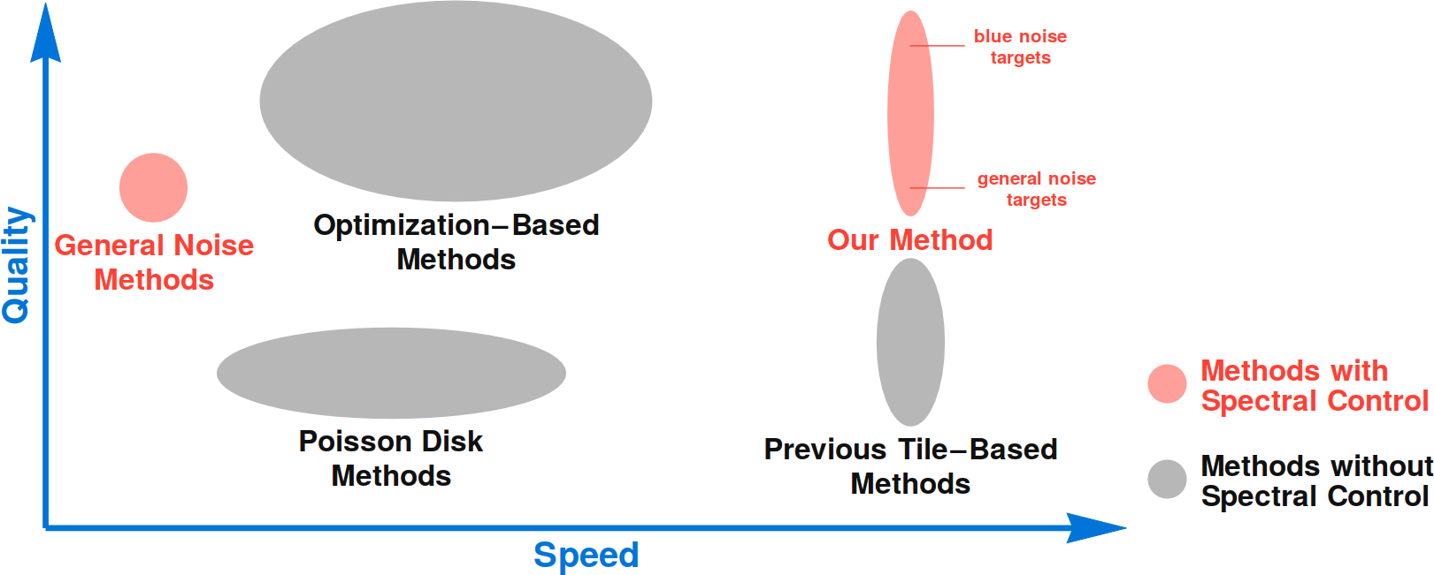
Previous work: Positioning
Notes:
We propose a sampling method that overcomes the drawbacks of previous tile-based methods
and that can generate sampling distributions of quality equivalent to the best state-of-the-art sampling methods.
As with General Noise methods, we can also produce distributions with user-specified Fourier spectra.

Slide 9
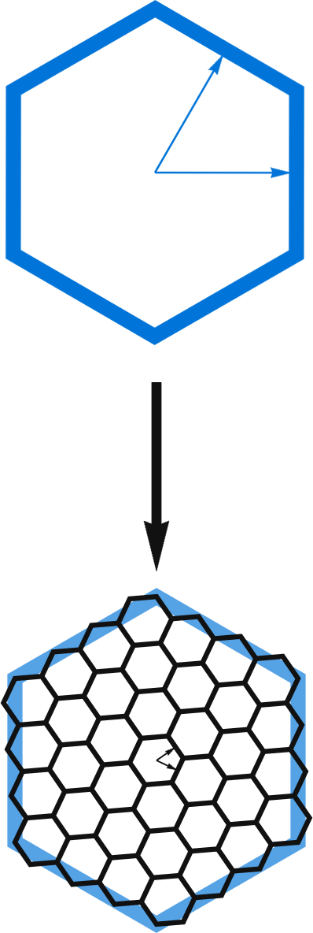
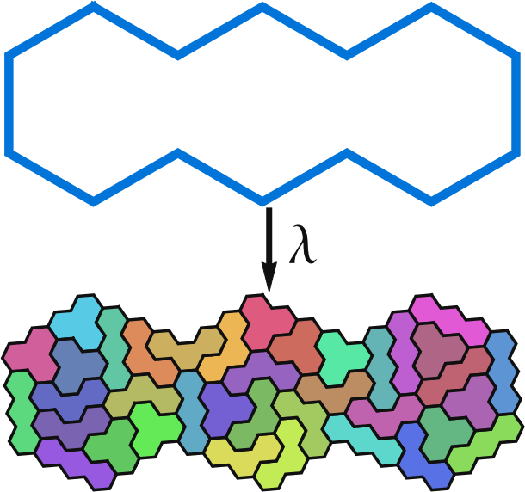
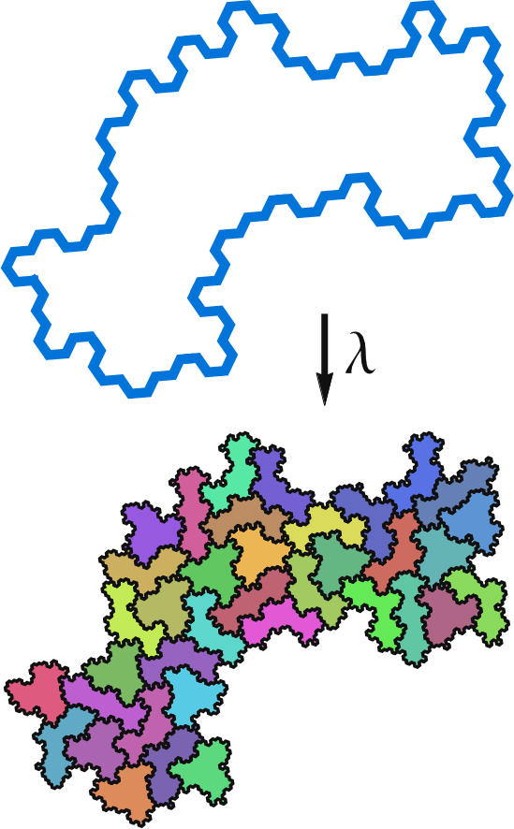
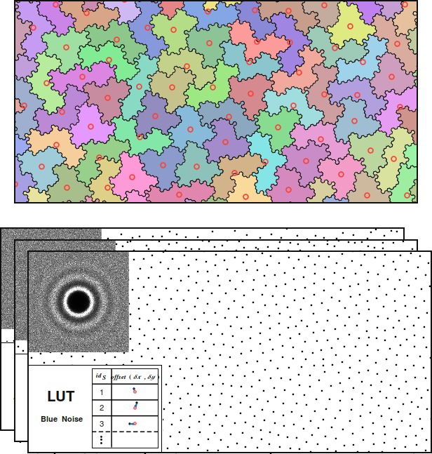
Outline
Hierarchical Tiling
Non-periodic Tiling
No pattern/regularities
Spectral control
Notes:
To achieve this goal, we need a hierarchical tiling system
====
that is non-periodic
====
and free of strong regularities.
====
Also, this tiling should support a sampling system with spectral control.

Slide 10
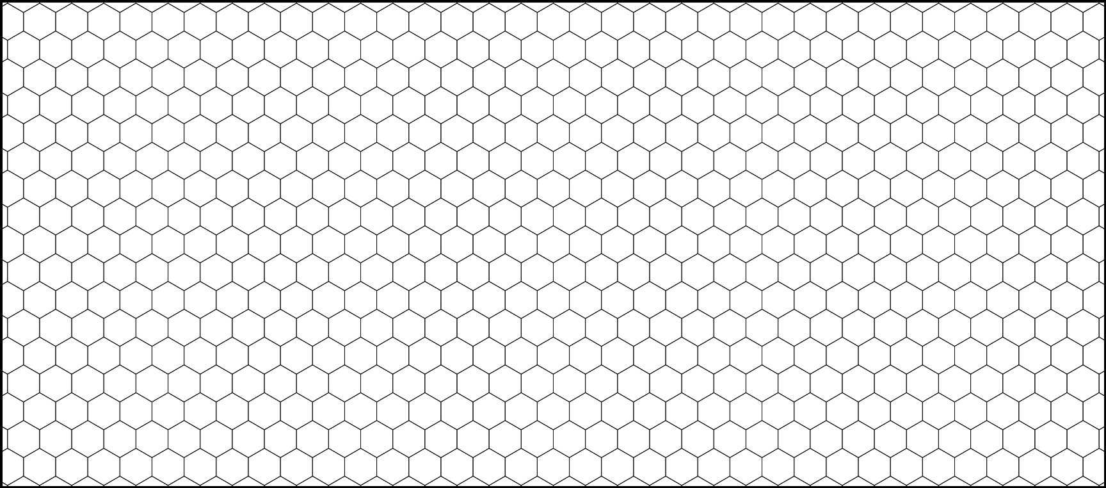
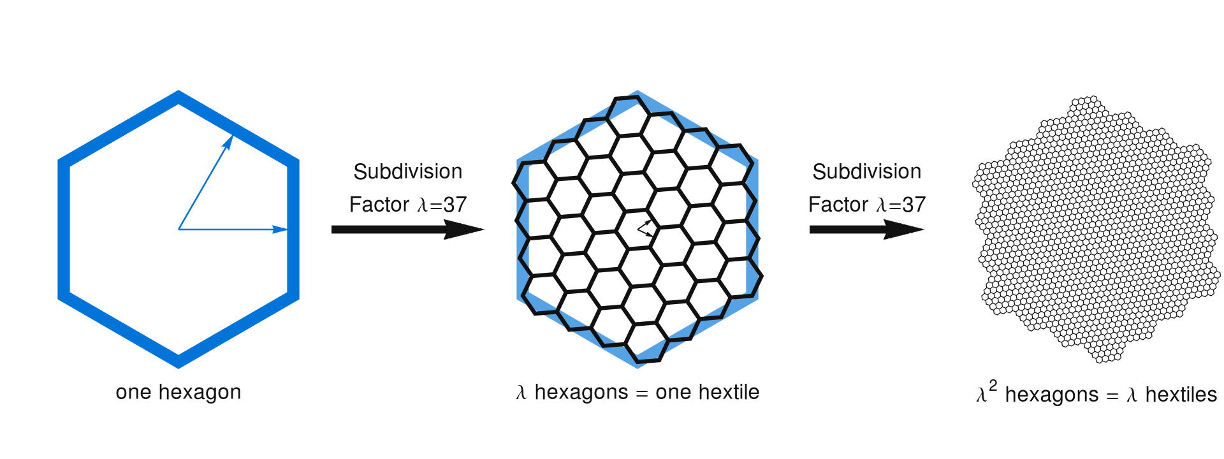
Base lattice
Hexagonal lattice
Recursive subdivision scheme
Notes:
The building blocks of our system are hexagons, which provide better anisotropy and simpler connectivity than squares.
Hexagons can also be recursively subdivided into smaller hexagons, thus densifying the underlying lattice.
& This hexagonal lattice is then used to build a more complex hierarchical non-periodic tiling system.

Slide 11
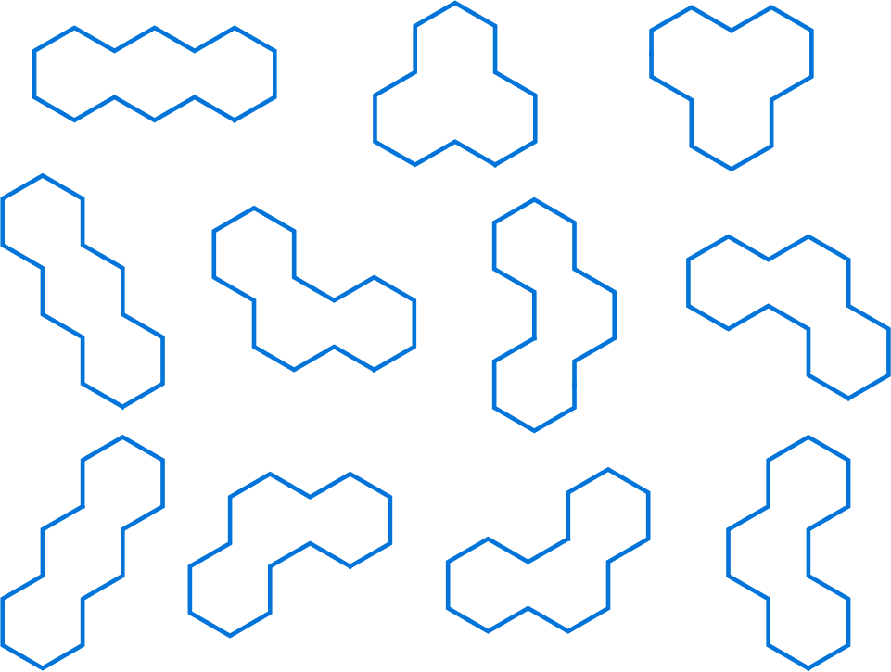
Polyhexes & Subdivision
11 possible trihexes
Subdivision rule for each trihex
Notes:
To construct this system, we group hexagons into connected triplets, which we call trihexes.
We then enumerate all possible geometric configurations of these trihexes, as shown here.
====
Within each trihex, the constituent hexagons are subdivided and clustered into further trihexes.
More details about this step can be found in the paper.
& These cluster and subdivision rules form a closed and finite subdivision system that is able to produce a hierarchical and non-periodic tiling.

Slide 12
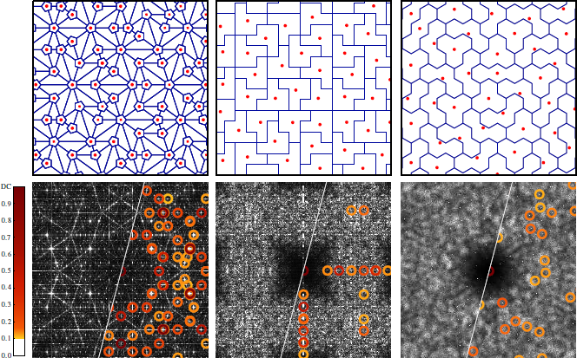
Comparison with previous systems
Penrose
Polyominoes
Trihexes
Notes:
The Fourier spectrum of this tiling is more isotropic than previous tile-based methods.
This is due both to the use of the hexagonal lattice, and to a much greater variety of tiles.
However, the tiling still contains small spectral peaks and regularities, as shown with red circles.
This is due to the fact that our tiling is generated by applying a recursive subdivision scheme in which tile borders are retained.
The result is that some alignments will arise on the borders of previous level of tiles.
This is enough to generate small but still harmful spectral peaks.

Slide 13
Irregular quasi-hexagonal lattice
Start from a standard hexagonal lattice
Notes:
To overcome this issue we define a new lattice … (from group of hexagons called hextiles.)

Slide 14
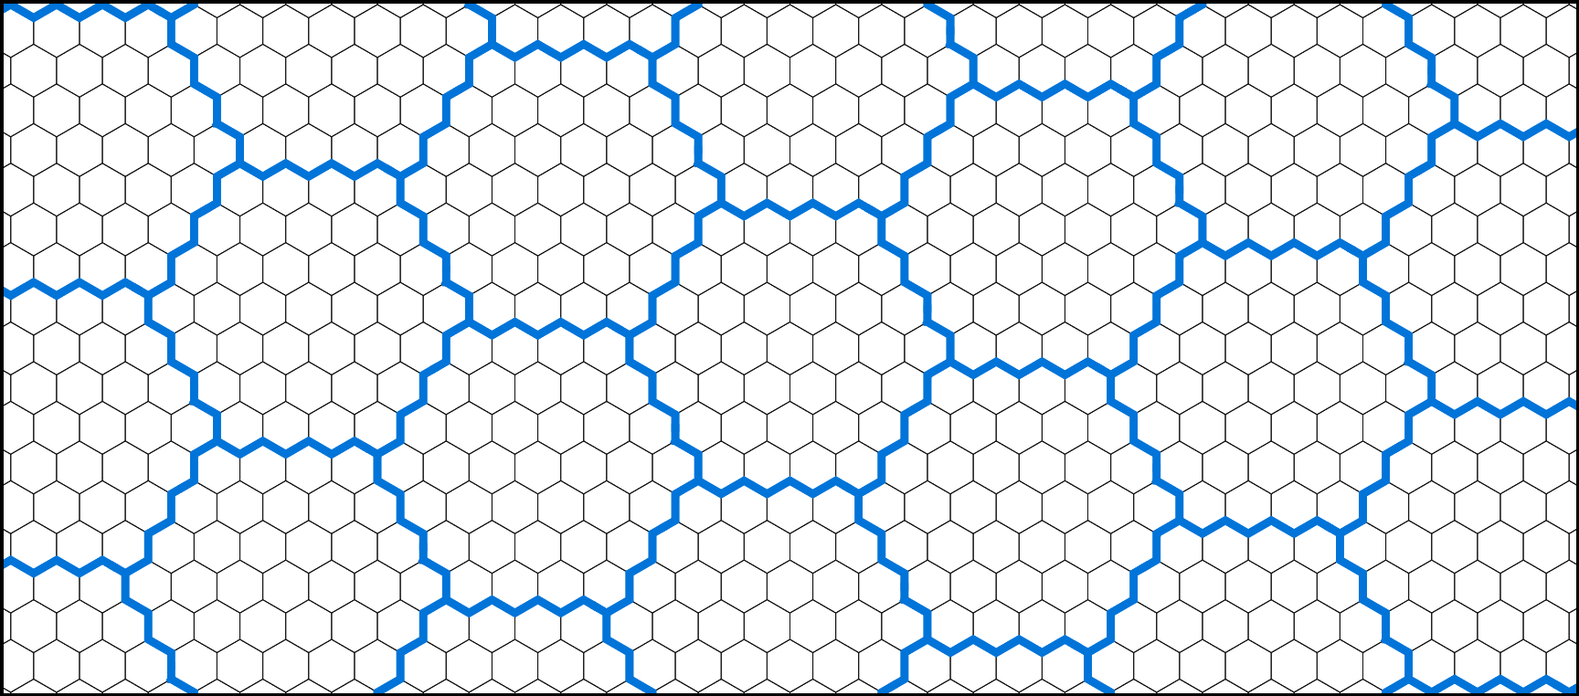
Irregular quasi-hexagonal lattice
Construct a quasi-hexagonal lattice of hextiles
Notes:
… from a group of hexagons called hextiles.

Slide 15
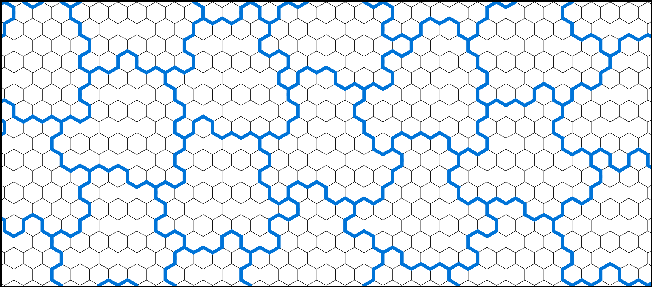
Irregular quasi-hexagonal lattice
Transformed in a quasi-hexagonal lattice of irregular hextiles
Notes:
These hextiles will be randomly perturbed at each subdivision to eliminate regularities in the tiling.

Slide 16
Irregular quasi-hexagonal lattice
Notes:
To shuffle the hextile borders while keeping their capacity constant … (we first consider triple-edge modifiers comprised of three connected borders.)
//
(kb) we didn’t define “capacity”, maybe change to “area”? I am not sure if people know “capacity”.

Slide 17
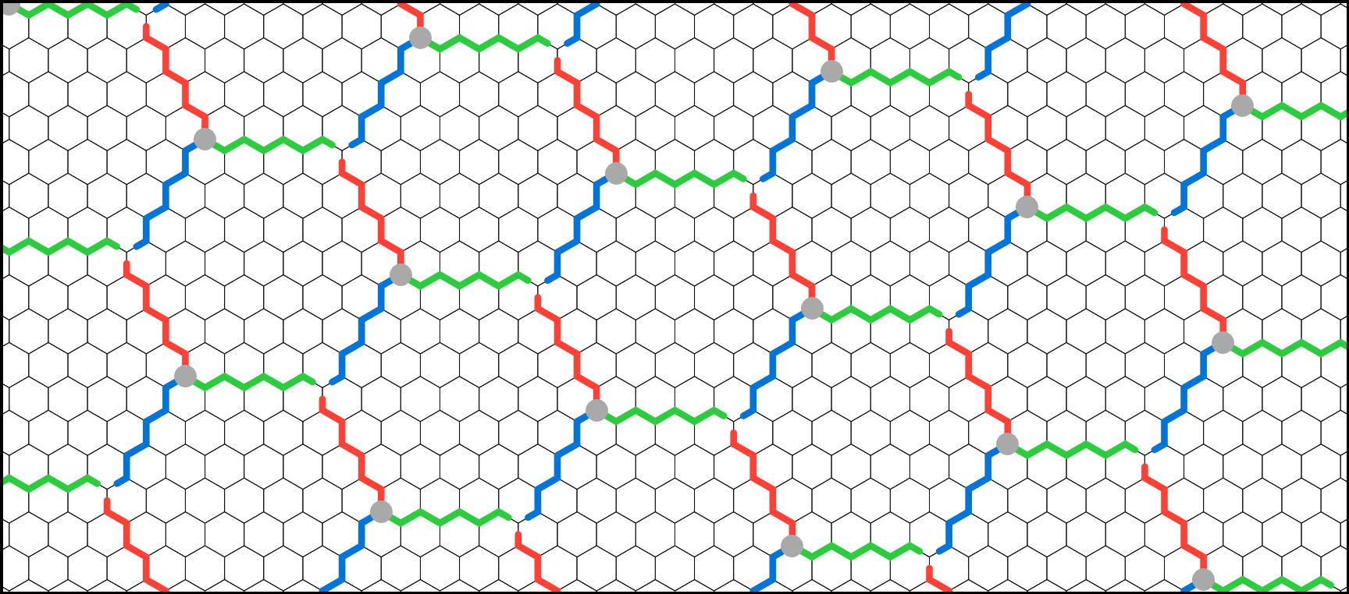
Irregular quasi-hexagonal lattice
Reassign hextiles borders to obtain triple-edge modifiers
Notes:
… we first consider triple-edge modifiers comprised of three connected borders.

Slide 18
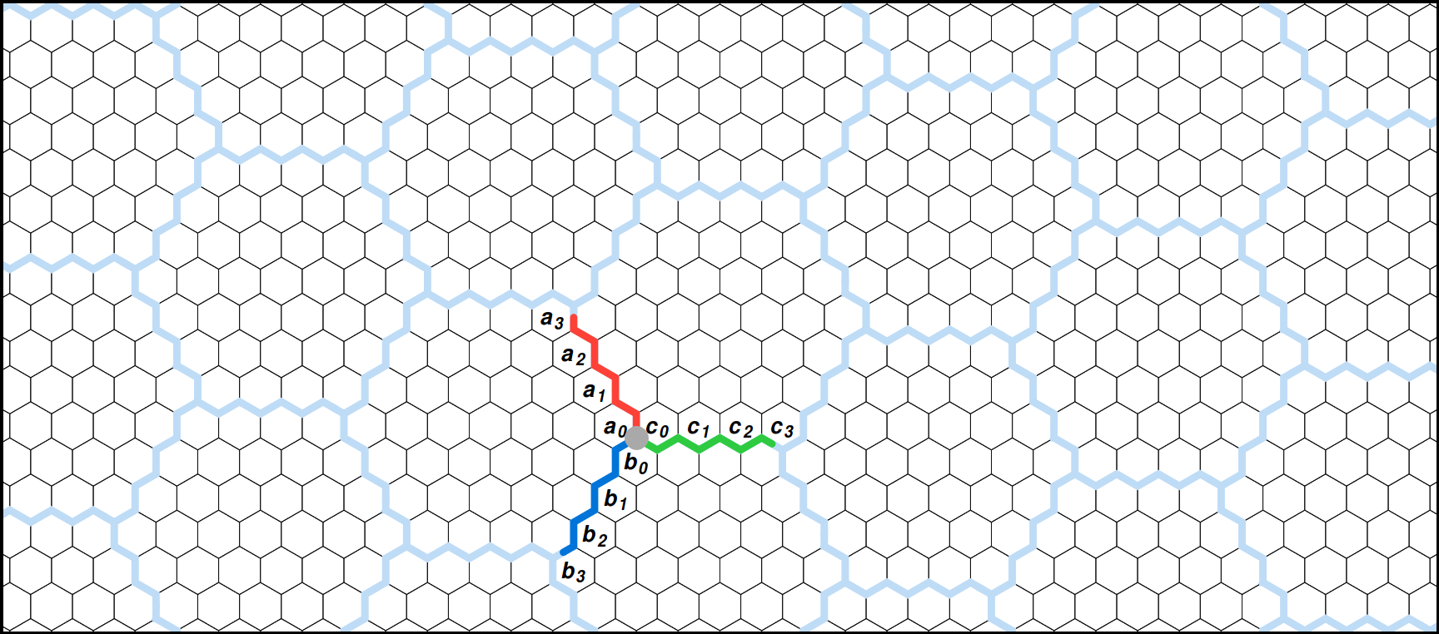
Irregular quasi-hexagonal lattice
A triple-edge modifier is defined by 3 binary words (A,B,C)
Notes:
Each of these triple-edge modifiers is characterized by three binary words.
A one bit in these words induces a local modification of the corresponding hextile border, swapping border hexagons from one hextile to another.
//
(kb) remember to pause here so they can really see the photo! it’s the best part.

Slide 19
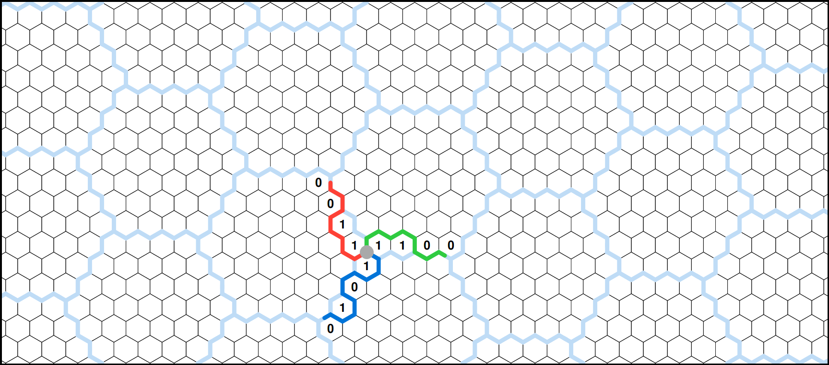
Irregular quasi-hexagonal lattice
These words are randomly set with an equal number of positive bits
Notes:
A stochastic process randomly selects these binary words from a set of admissible triple-edge modifiers.
Admissible modifiers are ones which preserve a seamless tiling and ensure that each tile has the same capacity.
Conditions sufficient to produce such modifiers are discussed in the paper.

Slide 20
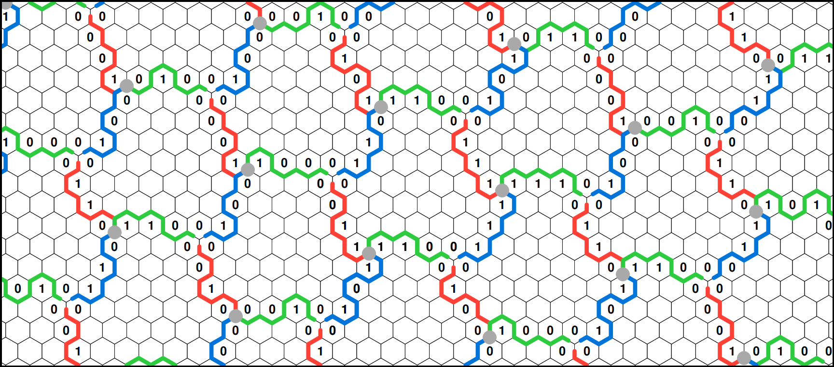
Irregular quasi-hexagonal lattice
Each triple-edge modifiers is randomly picked
Notes:
Once the set of all admissible modifiers has been computed, one is selected at random and assigned to each edge triplet …

Slide 21
Irregular quasi-hexagonal lattice
This construction guarantees equal capacity for all irregular hextiles
Notes:
thus producing irregular hextiles of equal capacity, forming an infinite lattice.

Slide 22
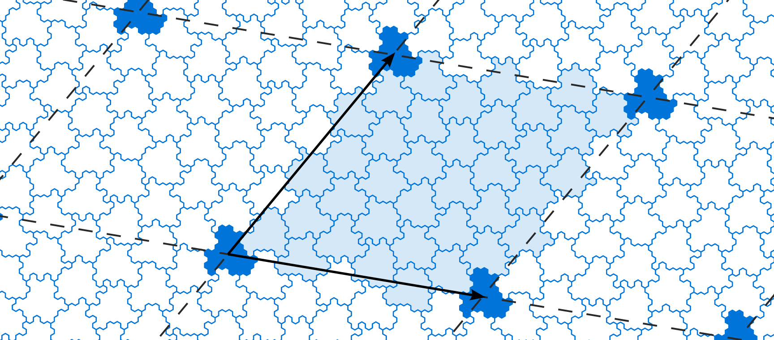
Irregular quasi-hexagonal lattice
Perturbation cover the plane through bi-periodicity
Notes:
To compute a finite library of irregular hextiles,
we apply this stochastic process to a finite set of hextiles in order to obtain a bi-periodic set of irregular hextiles.

Slide 23
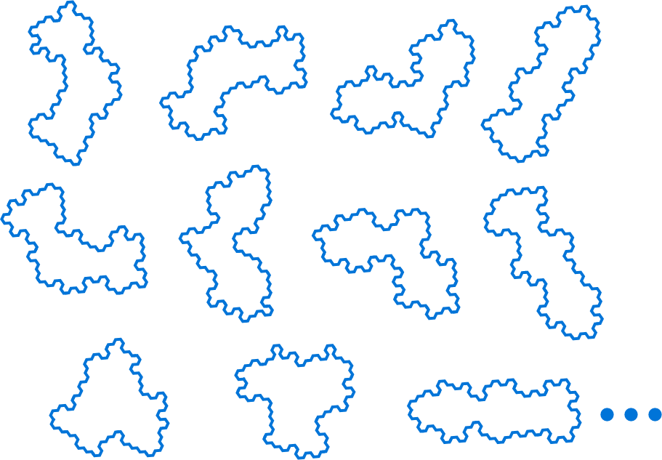
Irregular Polyhexes
Subdivision rule for each irregular trihex
11 ∙ λ possible irregular trihexes
Notes:
As before, to construct a hierarchical non-periodic tiling system, we enumerate all possible irregular trihexes on this lattice.
====
And for each of them, we construct a unique subdivision rule.

Slide 24
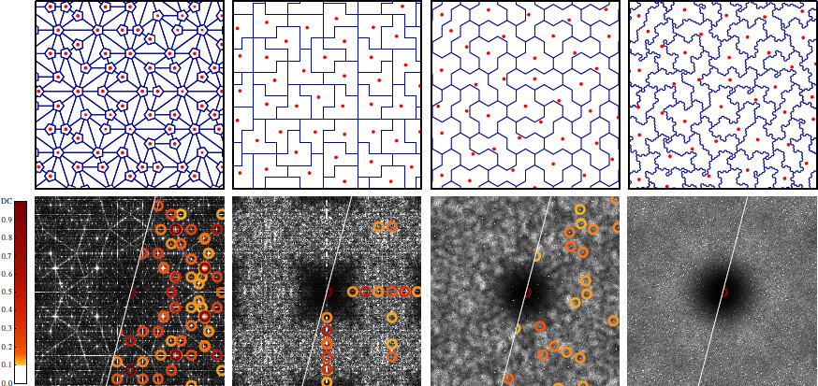
Comparison with previous systems
Penrose
Polyominoes
Trihexes
Irregular Trihexes
Notes:
By applying this set of deterministic subdivision rules, we achieve our goal of creating a non-periodic hierarchical tiling.
The distribution of tile barycenters is now free of spectral peaks and is nearly isotropic.
Thus, this tiling system provides a good basis for the construction of a high quality sampling system.

Slide 25
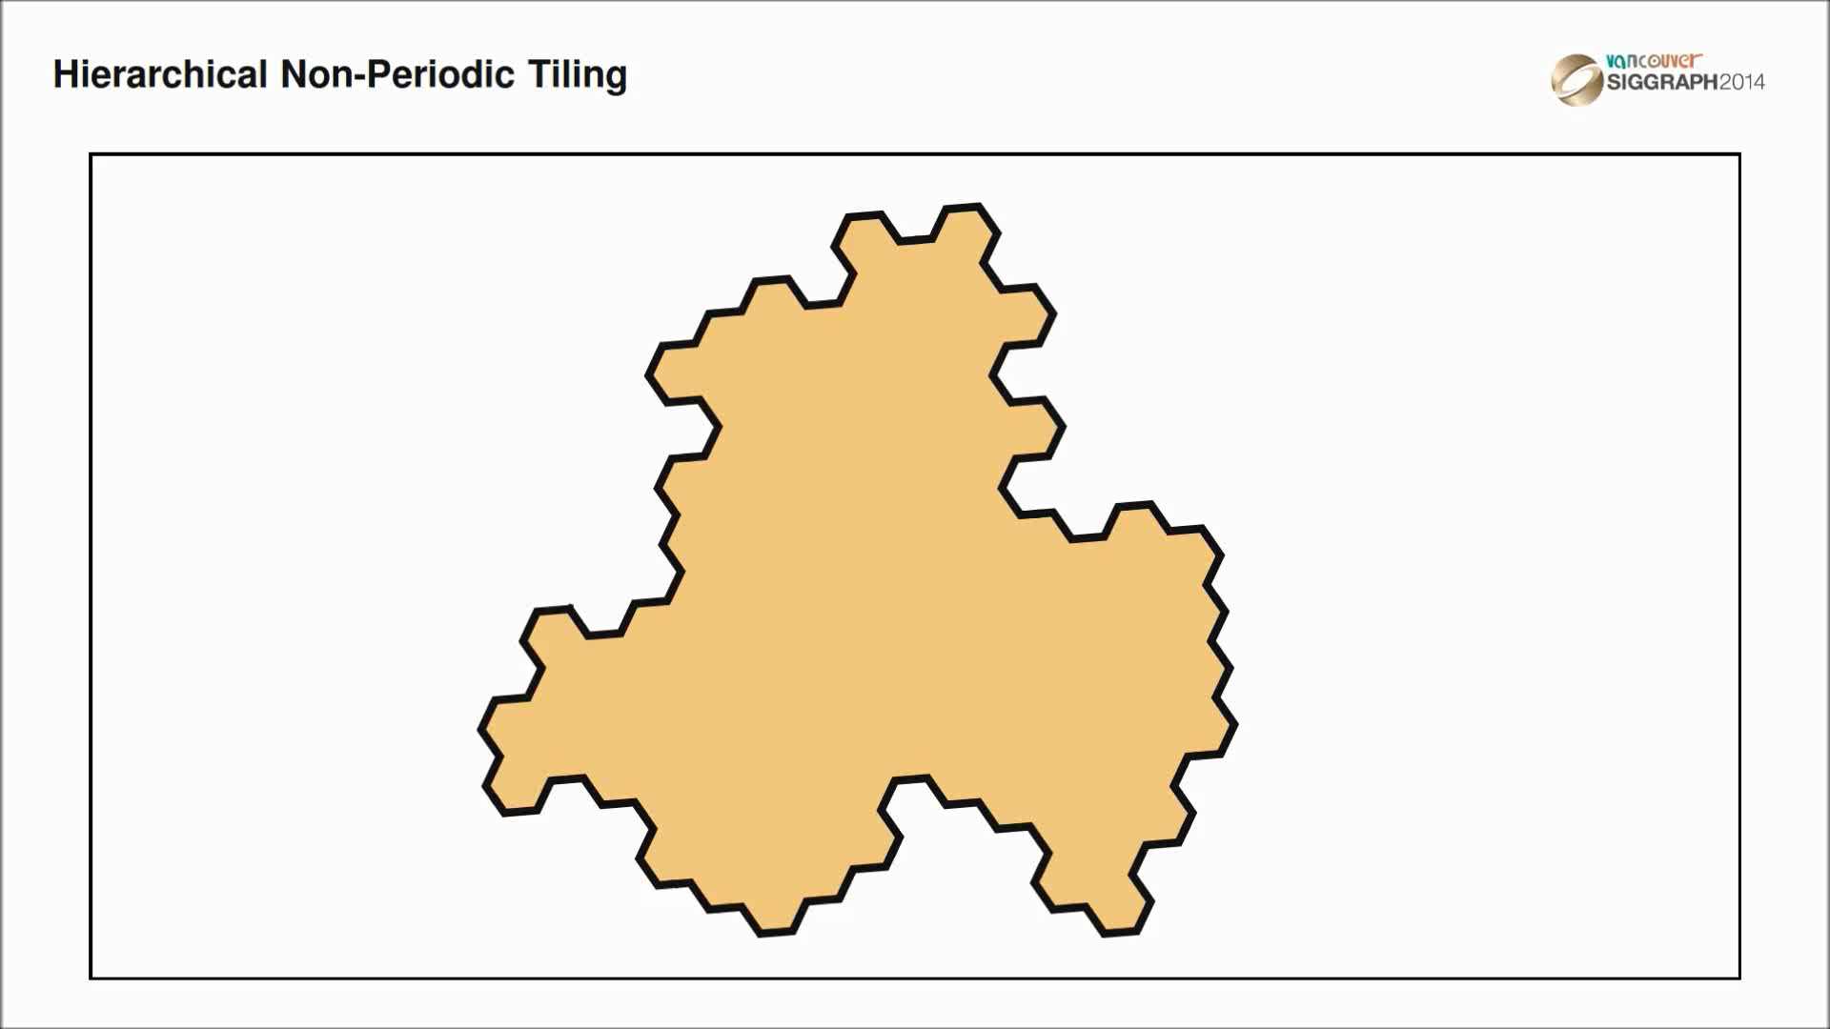
Sampling generation
Notes:
To calculate a sampling distribution, we start with an arbitrary irregular trihex, then we subdivide until we reach the desired sample density.
From this tiling, we compute the barycenter of each tile, thus initializing our base sample distribution.

Slide 26
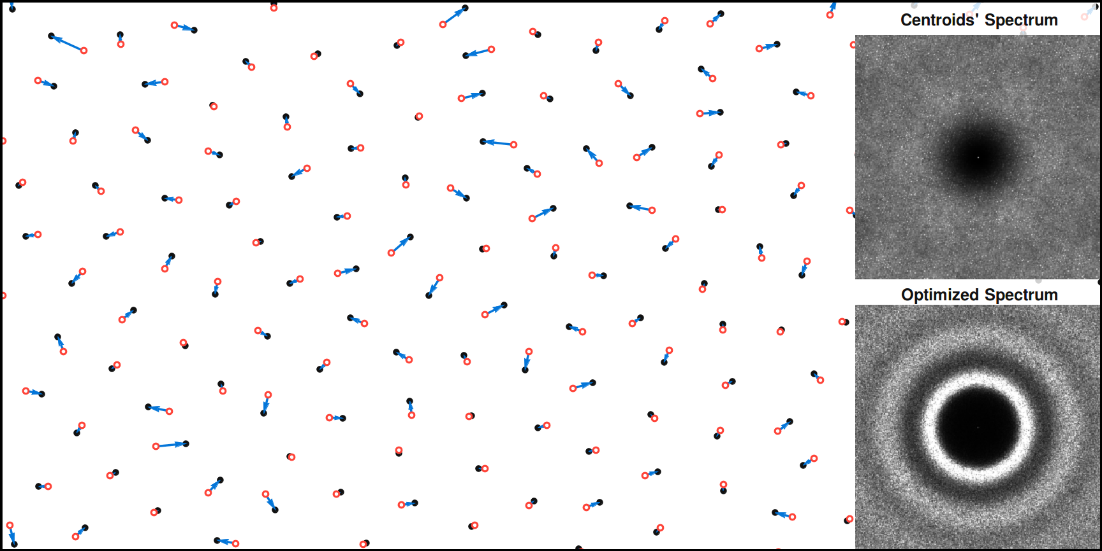
Sampling optimization
Notes:
These barycenters are then optimized in order to reach our desired sampling distribution.
Local offsets between tile barycenters and their optimized positions will then be sufficient to reshape the spectrum of the tiling into the desired profile.

Slide 27
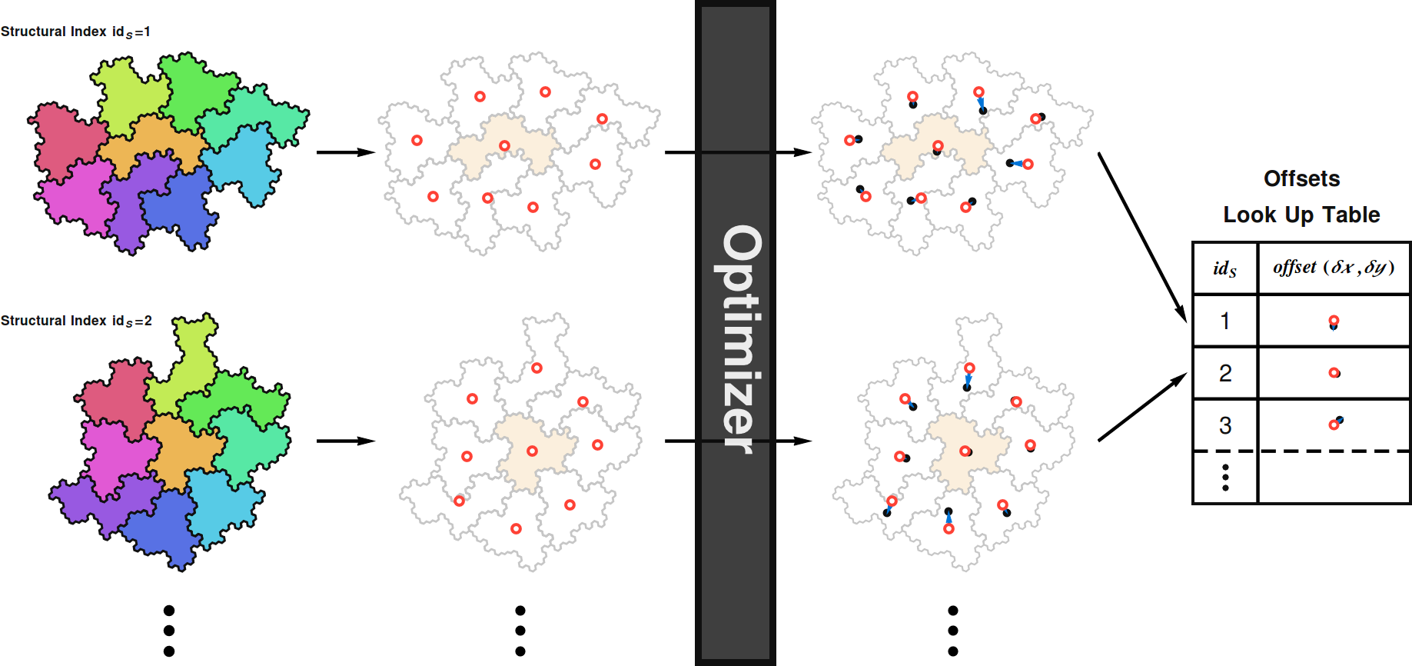
Sampling optimization
Notes:
To perform a full optimization, we generate a collection of patches from each irregular trihex in our library and their different possible tile neighborhood.
Each such patch is characterized by an unique structural index and contains a set of tile barycenters to be optimized.
The offset between the base position and the optimized one is then stored in a lookup table, sorted by its structural index.
You can also find details on this part in the paper.

Slide 28
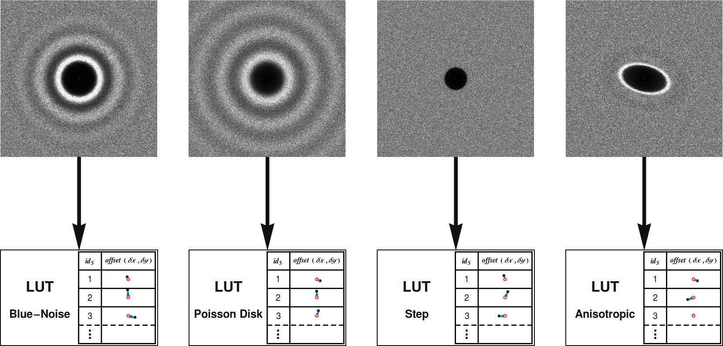
Sampling optimization
Notes:
Attaining a variety of spectral targets will require the computation of different lookup tables.
This precomputation phase is needed before fast sample generation can be performed.

Slide 29
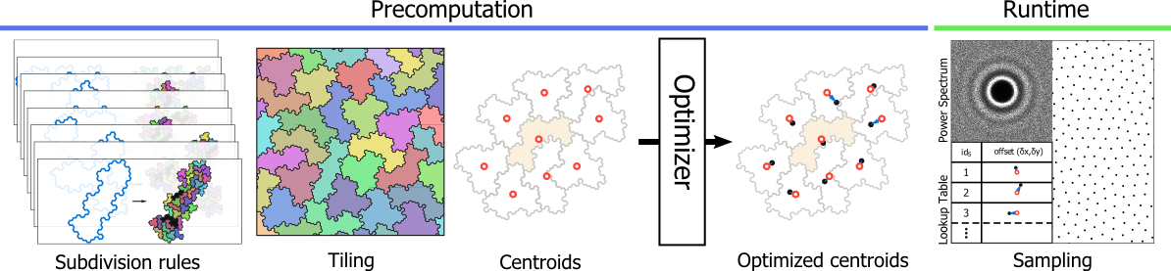
Overall pipeline
Notes:
In summary,
Subdivision rules allow us to generate a hierarchical non-periodic tiling where barycenters form a basic sample distribution.
The offset vectors obtained from the optimization of these samples are then stored in a lookup table.
The sampling phase consists of two simple steps:
generating a tiling with the desired density,
and then adding the precomputed offset vectors to the barycenters of each tile, forming the final distribution.

Slide 30

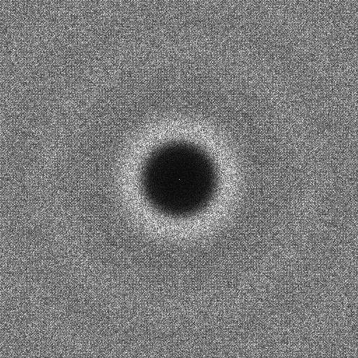

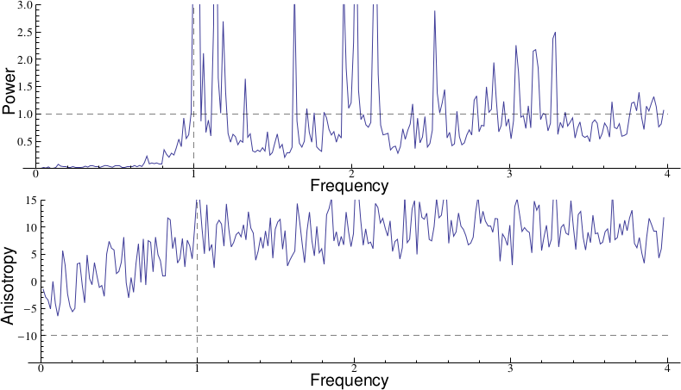
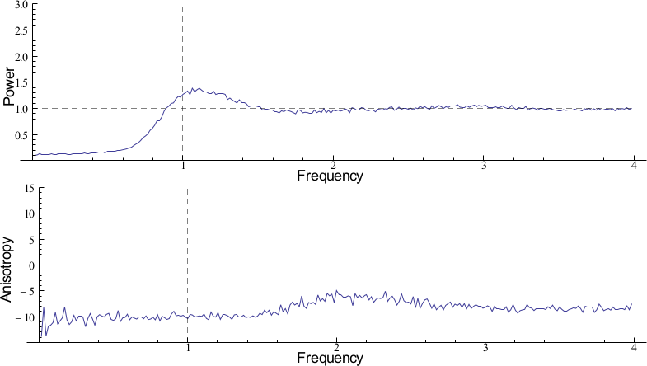

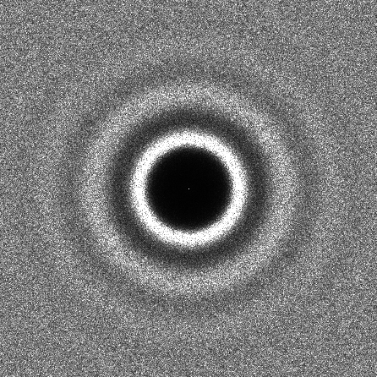

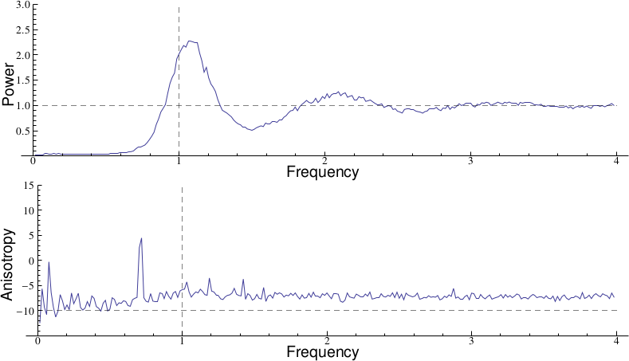

Results
Comparison with previous tile-based sampling methods
Penrose
Wang Tiles
Polyominoes
Our Result
Notes:
Compared to previous tile-based methods, this system produces blue-noise distributions of much better quality and without spectral peaks.

Slide 31




Results
Uniform blue-noise sampling
BNOT [De Goes et al. 2012]
Our Result
Notes:
In fact, for blue-noise sampling, we produce distributions of quality equivalent to the best state-of-the-art blue-noise methods.

Slide 32





Results
Uniform step-noise sampling
Step using [Heck et al. 2013]
Our Result
Notes:
Unlike previous tile-based methods, we can also produce more specific distributions like this step function spectrum.
The result is equivalent to general noise sampling methods.

Slide 33




Results
Examplar-based sampling
Empirical tree distribution in a forest from [Pommerening 2002]
Notes:
This spectral control allows us to reproduce real distributions.
Here we generate a forest with the same distribution properties as a real measured forest.

Slide 34
Results
Time in seconds to generate a distribution of N samples
Methods | 10k | 50k | 1M | 10M
CCVT | 157.000 | 4880.000 | - | -
BNOT | 6.000 | 65.000 | 10738.000 | -
General Noise (GPU) | 10.110 | 13.910 | 147.500 | -
Penrose | 0.730 | 4.550 | 11.800 | 80.400
Wang Tiles | 0.004 | 0.018 | 0.345 | 3.420
Polyominoes | 0.053 | 0.254 | 18.900 | 19.600
Ours | 0.016 | 0.067 | 0.989 | 9.280
Optimization-based Methods
Spectral control
Tile-based Methods
Notes:
In terms of speed, more than a million points can be generated per second, similar to previous tile-based methods.
This allows us to generate high quality blue-noise distributions at lower complexity.
For example, we generate one million points five orders of magnitude faster than the BNOT algorithm.

Slide 35

Results
Adaptive blue-noise sampling
Notes:
The hierarchical nature of our tiling system also makes it possible to generate adaptive samplings, in which the density of samples is locally proportional to an arbitrary function.

Slide 36
Contributions
A Novel Tiling System
Centroid Spectrum Free of Spurious Peaks
Hierarchical
Non-periodic
A Novel Sampling System
Spectral Control
Adaptive
Fast ( > 1M points /sec. /core )
Supplementary material and source code: http://liris.cnrs.fr/polyhex
Notes:
To summarize our contributions:
We have proposed a novel hierarchical and non-periodic tiling system.
The key property of this system is the absence of spectral peaks.
Secondly, we proposed a novel sampling system based on this tiling system, in which adaptive distributions can be generated with control over spectral characteristics.
If you would like additional information, supplementary material and source code can be found on our website.
Thank you.

